Slide 1
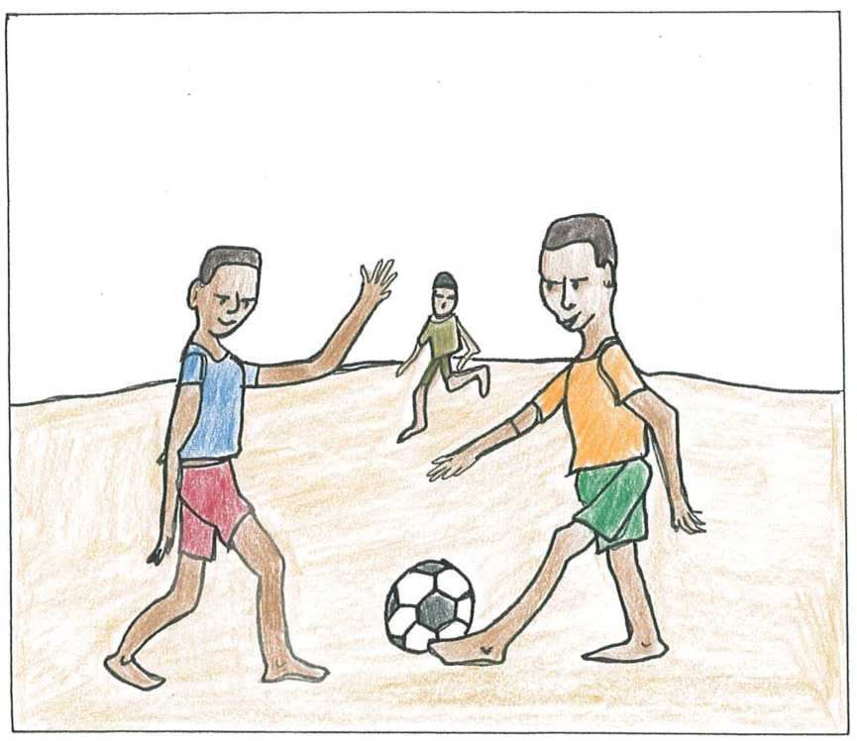
Dopo la scuola
Sue Worcester
Italian

Slide 2
Dopo la scuola (After School)
Level 1
Author and illustrator: Sue Worcester
Language: Italian
Translated by Riccardo Amorati and John Hajek
Read by Riccardo Amorati
The translation was developed with the assistance of the Research Unit for Multilingualism and Cross-cultural Communication (RUMACCC) at the University of Melbourne.
This audiobook was produced with the support of the Victorian Department of
Education and Training (DET).
For best results, please open with Acrobat Reader.
You are free to use, translate, adapt, copy and distribute these books. Books created using these pictures and/or text may not be sold or copyrighted.
This work is licensed under the Creative Commons Attribution-NonCommercial-ShareAlike 3.0 Unported License. To view a copy of this license, visit http://creativecommons.org/licenses/by-nc-sa/3.0/.
For more books and further information, visit: www.arts.unimelb.edu.au/rumaccc/resources.
Edition: February 2021

Slide 3
Dopo la scuola giochiamo a calcio.

Slide 4
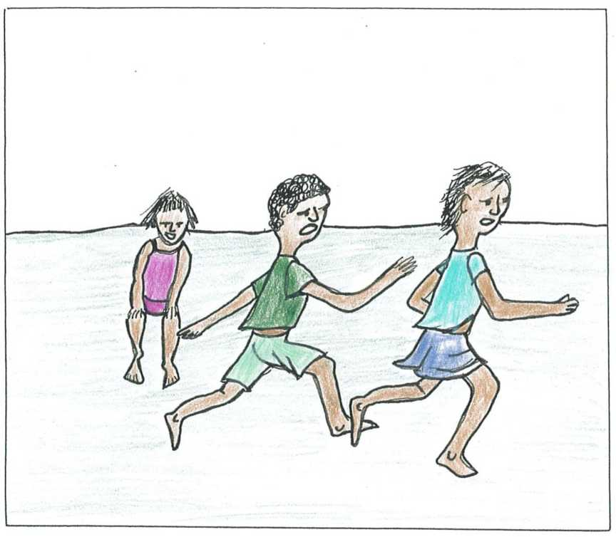
Dopo la scuola giochiamo a rincorrerci.

Slide 5
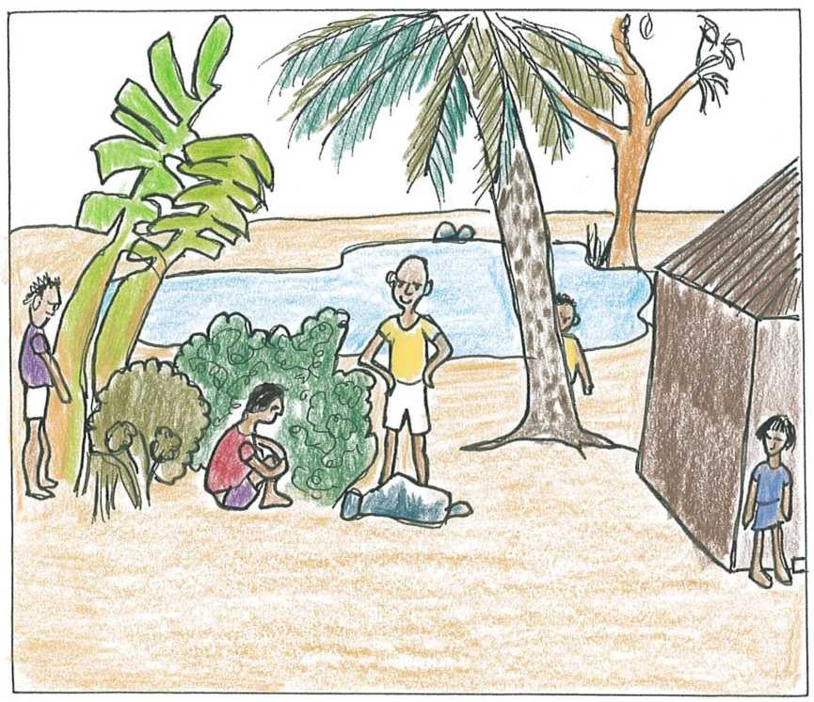
Dopo la scuola giochiamo a nascondino.

Slide 6
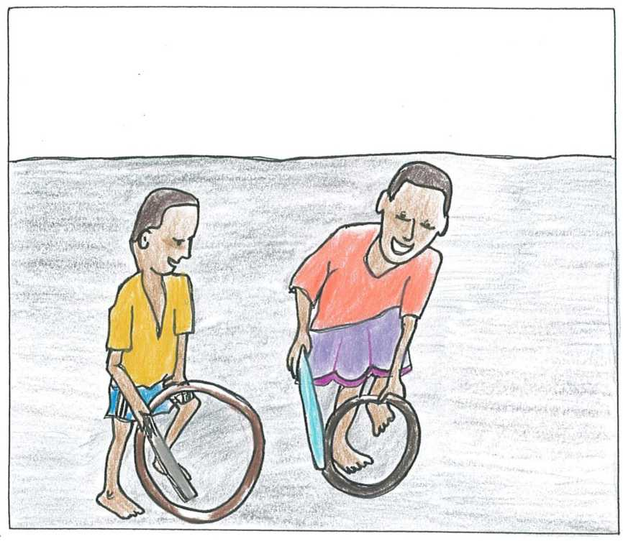
Dopo la scuola giochiamo con i cerchi.

Slide 7
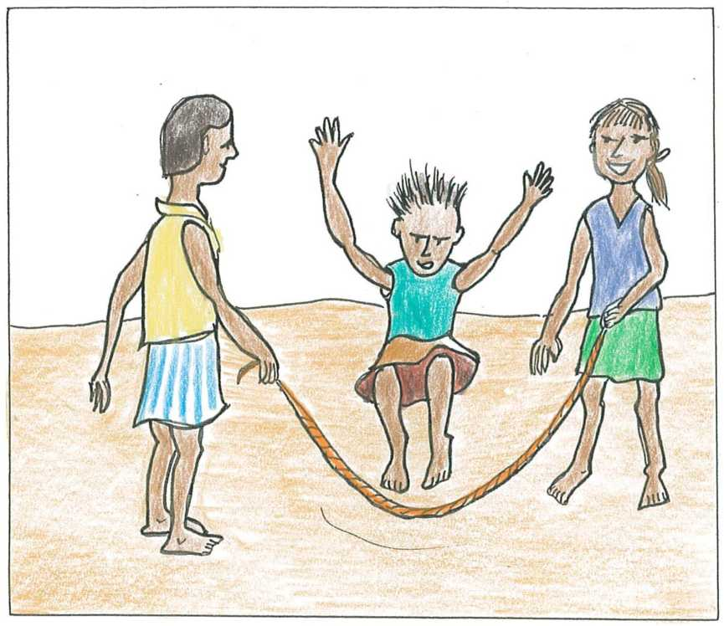
Dopo la scuola saltiamo la corda.

Slide 8
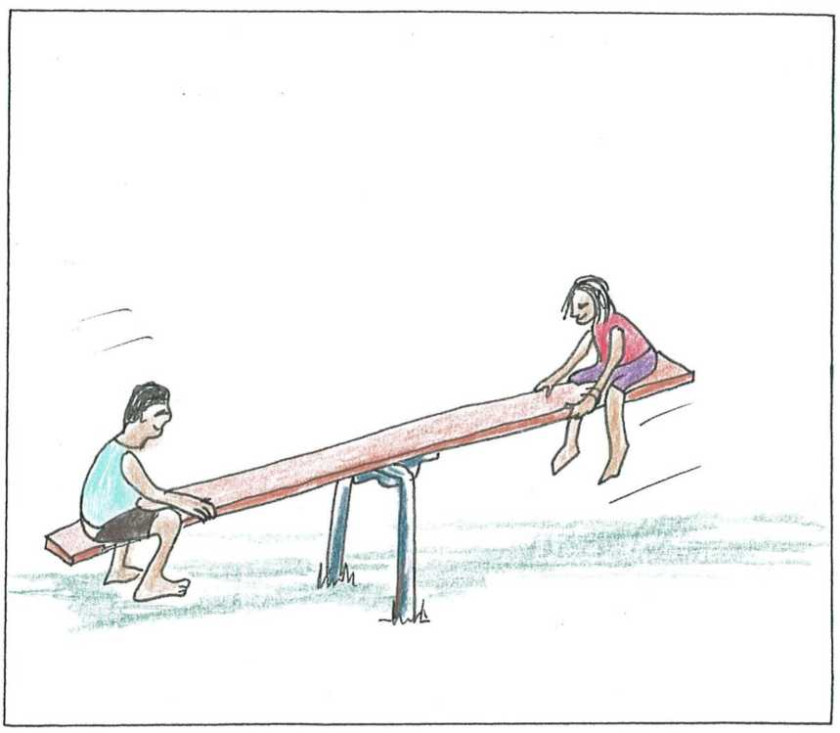
Dopo la scuola giochiamo sul dondolo.

Slide 9
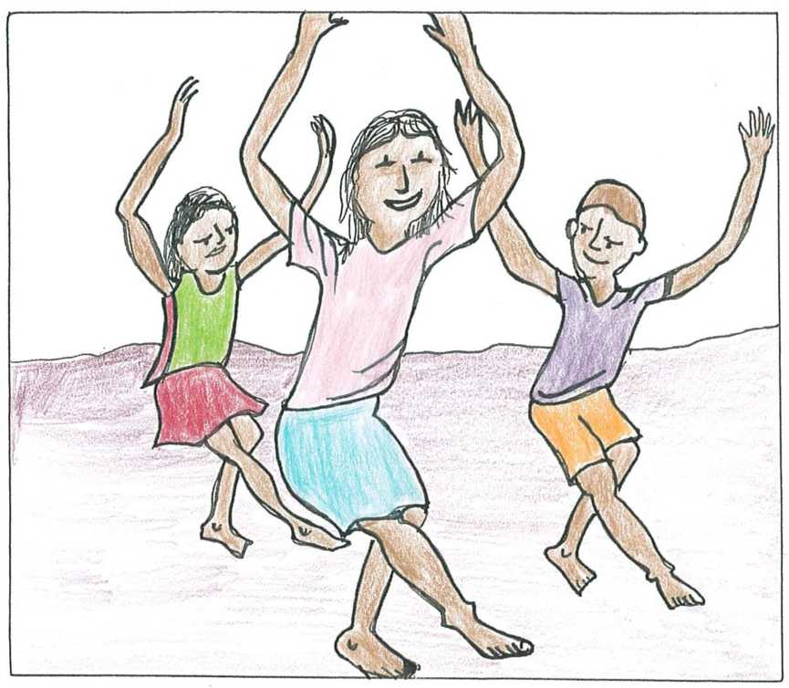
Dopo la scuola balliamo.

